Slide 1

Netflix Content Trends: A Strategic Analysis (2008–2021)
VIDYADHEESHA M PANDURANGI
Internship ID: INTERNSHIP_172663295366ea53f910591
Apply ID: APPLY_175561522668a48ffa9b8df
AICTE STUDENT REGISTRATION ID: STU667711a678b251719079334

Slide 2

PROBLEM STATEMENT
Netflix has become one of the most prominent global streaming platforms, continuously expanding its library with a mix of original productions and licensed content. However, with growing competition from platforms like Amazon Prime, Disney+, and regional OTT providers, Netflix must strategically analyze its content catalog to identify strengths, gaps, and opportunities.
The specific problem to be addressed in this project is 'Content Trends Analysis for Strategic Recommendations'. The aim is to uncover how Netflix’s content distribution (Movies vs. TV Shows, genres, and country contributions) has evolved over the years. This will enable the identification of key genres, audience preferences, and strategic insights into global content expansion.

Slide 3
This project undertakes a focused analysis of the Netflix content library, utilizing a dataset containing 7,789 records of Movies and TV Shows spanning content added between 2008 and 2021. The central purpose is to perform a Strategic Content Trends Analysis designed to uncover the platform’s evolutionary shifts in content focus, geographical sourcing, and genre priorities. This investigation is critical in the context of fierce global competition from rival streaming services, necessitating data-driven strategic adjustments. The specific challenge addressed is how to sustain Netflix’s competitive advantage by scientifically identifying strengths, gaps, and future opportunities within its content portfolio. The analysis begins with essential data preparation, ensuring the integrity of the 7,789 entries, particularly cleaning and standardizing categorical fields such as director, cast, country, and listed genres, which often contain multiple values. Following this, Exploratory Data Analysis (EDA) is conducted using visualization and statistical modeling to examine time-based trends in content distribution.
PROJECT DESCRIPTION

Slide 4

WHO ARE THE END USERS?
Netflix Content Strategy & Acquisition Teams
To make data-driven decisions on where to allocate the multi-billion dollar content budget.
Netflix Original Programming (Production) Team
To guide the development and greenlighting process for Netflix's own original content (Netflix Studios).
Executive and Strategy Leadership
To formulate high-level business strategy, assess competitive positioning, and guide international market expansion.
Third-Party Content Creators and Studios
To understand content demands and trends on the world's largest streaming platform.
Data Scientists and Researchers
To utilize the analysis methodology as a foundation for further research and modeling.

Slide 5

TECHNOLOGY USED
Jupyter Notebook
Provides an interactive environment for coding, data analysis, and visualization.
Supports step-by-step execution, making it ideal for exploratory data analysis (EDA).
Python Libraries
NumPy (numpy as np)
Used for numerical computations and handling multi-dimensional arrays.
Provides mathematical functions for efficient data manipulation.
Pandas (pandas as pd)
Used for data cleaning, transformation, and manipulation.
Provides DataFrame and Series structures for handling structured datasets.
Matplotlib (matplotlib.pyplot as plt)
Fundamental library for creating static visualizations.
Useful for line charts, bar graphs, histograms, and scatter plots.
Seaborn (seaborn as sns)
Built on top of Matplotlib, designed for statistical data visualization.
Helps create more informative and attractive plots like heatmaps, boxplots, etc.
Plotly Express (plotly.express as px)
Used for creating interactive visualizations.
Enables dynamic charts and dashboards for deeper data insights.

Slide 6
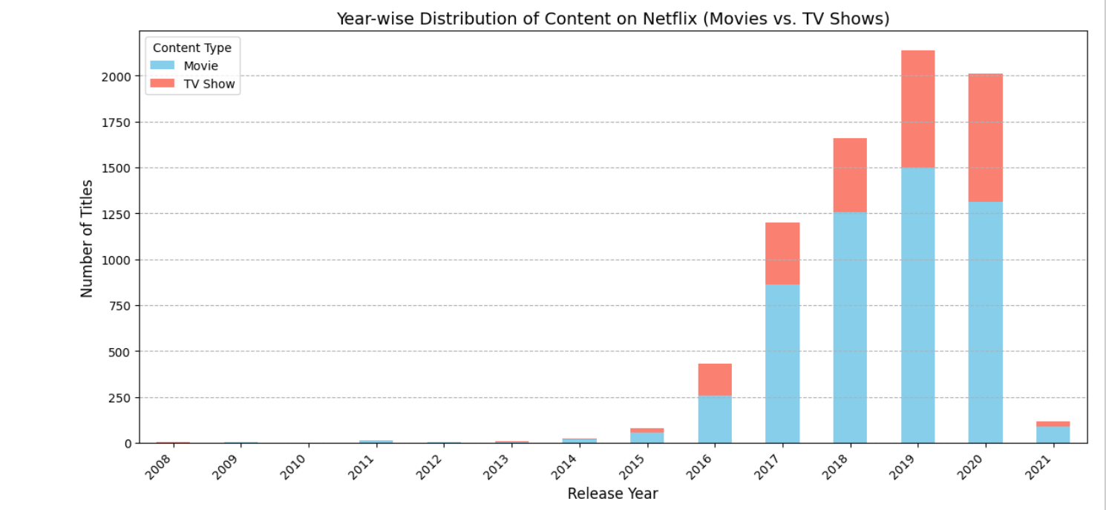
RESULT - 01
Fig: 01 – Plot of Year-wise Distribution of Content on Netflix (Movies vs. TV Shows)

Slide 7
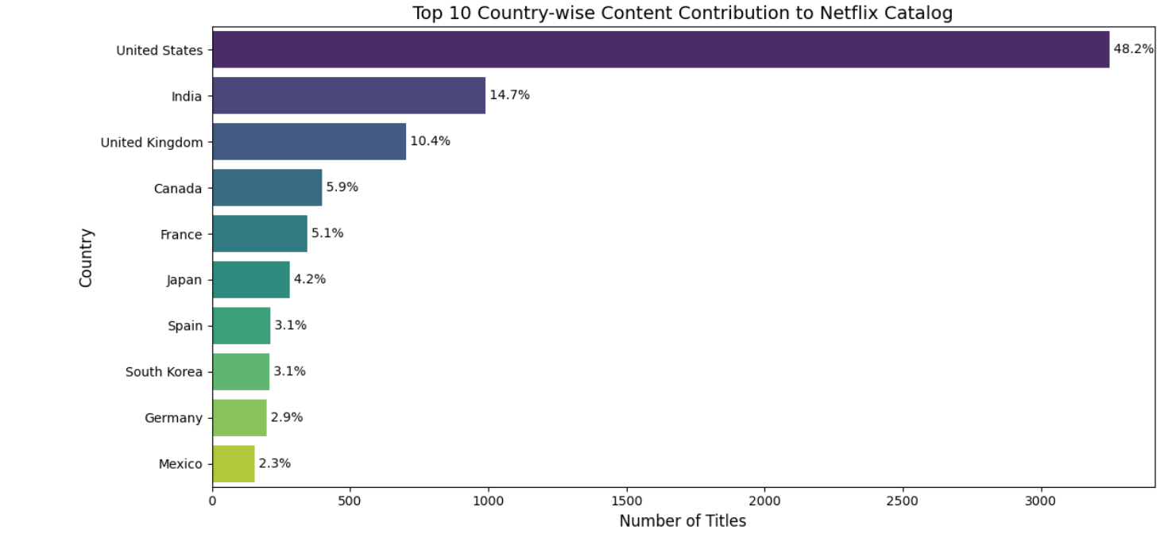
RESULT - 02
Fig: 02 – Plot of Top 10 Country-wise Content Contribution to Netflix Catalog

Slide 8
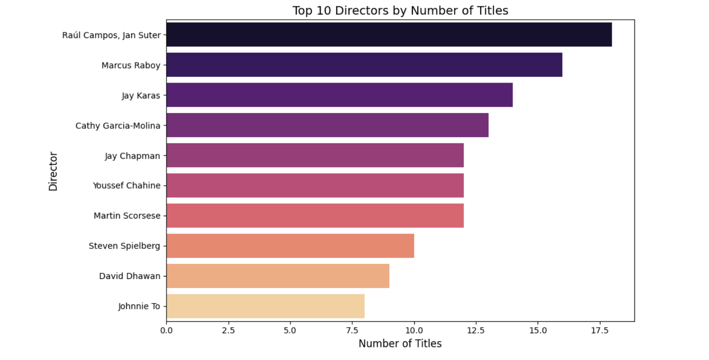
RESULT - 03
Fig: 03 - Plot of Top 10 Directors by Number of Title

Slide 9
GITHUB REPOSITORY
GitHub Link:
https://github.com/Vidyadheesha-M-Pandurangi/Netflix_Content_Trends_A_Strategic_Analysis_2008-2021.git

Slide 10

GETTING STARTED WITH BASICS OF PYTHON CERTIFICATE

Slide 11
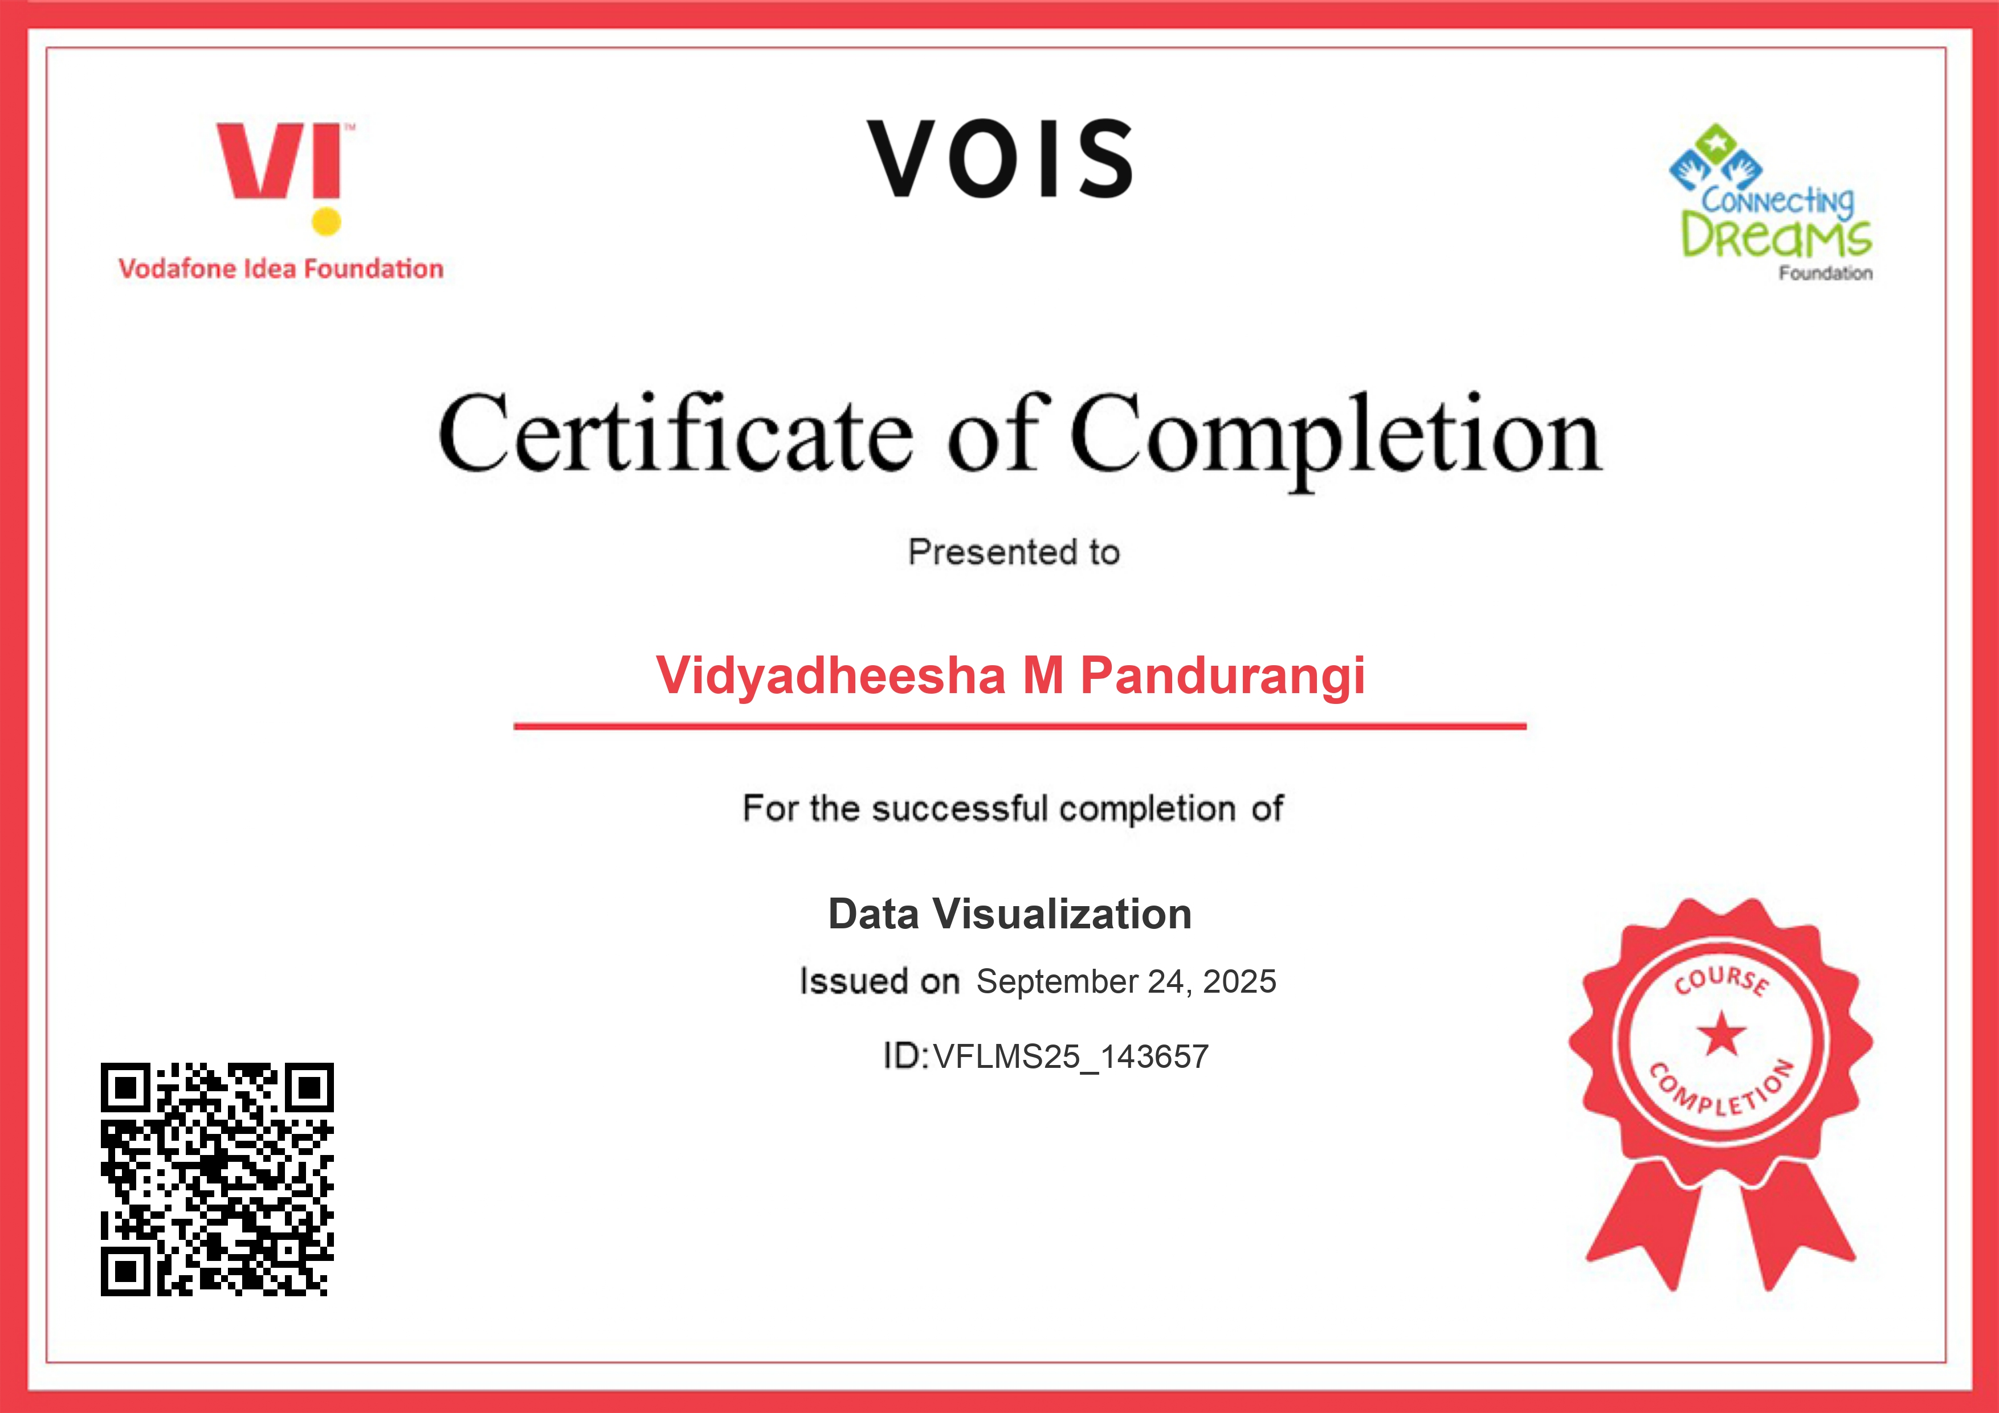
DATA VISUALIZATION CERTIFICATE

Slide 12
THANK YOU
.

